Slide 1
Web Technologies
JS Basics

Slide 2
Summary of Today’s Lecture
JavaScript Introduction
Variable Declaration
Data Types
Comparison Operators
Arithmetic Operators

Slide 3

JavaScript
JavaScript springs into action when the user asks the page to perform a task.
The problem is that HTML and CSS aren’t really interactive.
  certainly are CSS tricks you can use to manipulate styles in very specific situations, such as mouse hovers over links, but your options are fairly limited if you’re using just HTML and CSS.
JavaScript allows you to detect just about anything that takes place in a web page, like a user clicking buttons, resizing the browser window, or entering data into a text field.
And since JavaScript is a scripting programming language, you can learn to write code to respond to these user interactions, like performing a calculation, dynamically swapping images on the page, or even validating data.

Slide 4
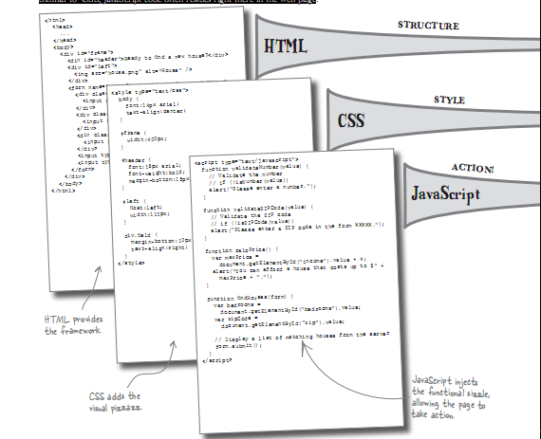
JavaScript

Slide 5
JavaScript versions
JavaScript was invented by Brendan Eich in 1995, and became an ECMA standard in 1997.
ECMAScript is the official name of the language.
ECMAScript versions have been abbreviated to ES1, ES2, ES3, ES5, and ES6.
  The Original JavaScript ES1 ES2 ES3 (1997-1999)
  The First Main Revision ES5 (2009)
  The Second Revision ES6 (2015)
  The Yearly Additions (2016, 2017, 2018, 2019, 2020)
Since 2016 new versions are named by year (ECMAScript 2016 / 2017 / 2018, 2019, 2020).

Slide 6
Additional to Server-side scripting
Why also use client-side scripting?
client-side scripting (JavaScript) benefits:
Client-side validation
efficiency: can make small, quick changes to page without waiting for server
event-driven: can respond to user actions like clicks and key presses

Slide 7
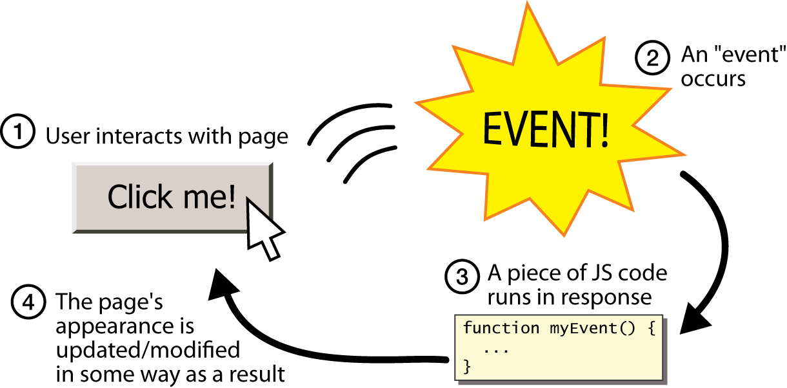
Event-driven programming

Slide 8
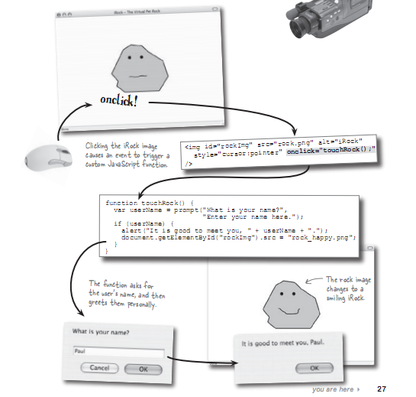

Slide 9
Adding JavaScript to a Page
Like CSS, you can embed a script right in a document or keep it in an external file and link it to the page. Both methods use the script element.
Embedded Script
  To embed a script on a page, just add the code as the content of a script element:
    <script>
      … JavaScript code goes here
    </script>
  External scripts
  The other method uses the src attribute to point to a script file (with a .js suffix) by its URL. In this case, the script element has no content.
    <script src="my_script.js"></script>

Slide 10
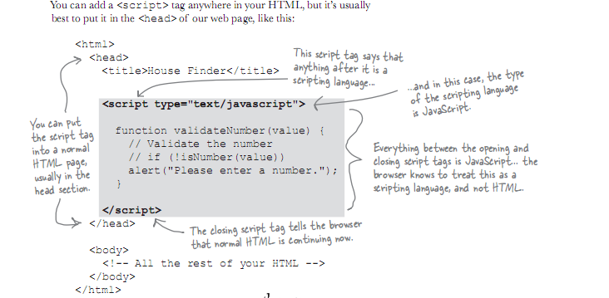

Slide 11
Variables (var)
A variable is like an information container. You give it a name and then assign it a value, which can be a number, text string, an element in the DOM, or a function.
The general rules for constructing names for variables (unique identifiers) are:
  Names can contain letters, digits, underscores, and dollar signs.
  Names must begin with a letter, $ or _.
  Names are case sensitive (y and Y are different variables)
  Reserved words (like JavaScript keywords) cannot be used as names
  The following declaration creates a variable with the name “foo” and assigns it the value 5:
    var foo = 5;
    var person = "John Doe",
    carName = "Volvo",
    price = 200;

Slide 12
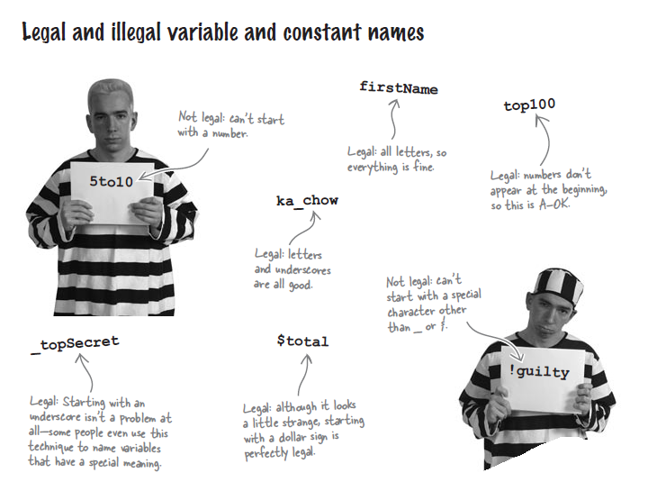

Slide 13
Variable Scope
The notion of the availability of the variable is known as its scope.
A variable that can be used by any of the scripts on your page is globally scoped.
A variable that’s available only within its parent function is locally scoped.
JavaScript variables use functions to manage their scope. If a variable is defined outside of a function, it will be globally scoped and available to all scripts.
Global variables can be accessed from anywhere in a JavaScript program.
  var carName = "Volvo";
  // code here can use carName
  function myFunction() {
  // code here can also use carName
  }
Variables declared Locally (inside a function) have Function Scope.
  // code here can NOT use carName
  function myFunction() {
  var carName = "Volvo";
  // code here CAN use carName
  }
  // code here can NOT use carName

Slide 14
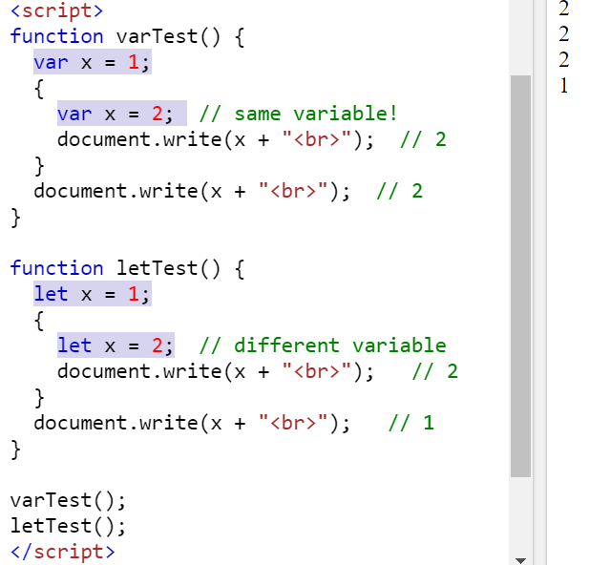
Variables (let)
Before ES2015 (ES6), JavaScript had only two types of scope: Global Scope and Function (local) Scope.
ES6 introduces the new let keyword for declaring variables. Prior to ES6, the only way to declare a variable in JavaScript was the var keyword.
Variables declared by let have their scope in the block for which they are defined, as well as in any contained sub-blocks.
Block scoping simply means that a new scope is created between a pair of curly brackets i.e. {}.
Therefore, if you declare a variable with the let keyword inside a block, it does not exist outside of the block.

Slide 15
Variables (const)
Variables defined with const behave like let variables, except they cannot be reassigned:
  const PI = 3.141592653589793;
  PI = 3.14; // This will give an error
  PI = PI + 10; // This will also give an error
Declaring a variable with const is similar to let when it comes to Block Scope.
The x declared in the block, in this example, is not the same as the x declared outside the block:
  var x = 10;
  // Here x is 10
  {
  const x = 2;
  // Here x is 2
  }
  // Here x is 10

Slide 16
Data types
JavaScript has dynamic types. This means that the same variable can be used to hold different data types.
  var x; // Now x is undefined
  x = 5; // Now x is a Number
  x = "John"; // Now x is a String
Undefined
  The simplest of these data types is “undefined.” If we declare a variable by giving it a name but no value, that variable contains a value of “undefined.”
    var foo;
    alert(foo); // This will open a dialog containing "undefined“.
Boolean
  Booleans can only have two values: true or false.
    var foo = true; // The variable "foo" is now true

Slide 17
Data types
Numbers
  You can assign variables numeric values.
    var foo = 5;
    alert(foo); // This will open a dialog containing "5".
JavaScript is “loosely typed,” we don’t have to tell our script to treat the variable foo as the number five.
We can use classic mathematical notation: +, -, *, and / for plus, minus, multiply, and divide, respectively.
In this example, we use the plus sign (+) to add foo to itself (foo + foo).
    var foo = 5;
    alert(foo + foo); // This will alert "10".
Strings
  Another type of data is a string, which is basically a line of text. Enclosing characters in a set of single or double quotes indicates that it’s a string, as shown here:
  var foo = "five";
  alert( foo ); // This will alert "five"

Slide 18
Data types
When the plus sign is used with strings, it sticks the strings together (called concatenation) into one long string, as shown in this example.
  var foo = "bye"
  alert (foo + foo); // This will alert "byebye“
  var foo = "5";
  alert( foo + foo ); // This will alert "55“
  var foo = "five";
  var bar = 5;
  alert( foo + bar ); // This will alert "five5“
  Objects
  The object is a complex data type that allows you to store collections of data.
  An object contains properties, defined as a key-value pair. A property key (name) is always a string, but the value can be any data type, like strings, numbers, booleans, or complex data types like arrays, functions and other objects.
  var person = {firstName:"John", lastName:"Doe", age:50, eyeColor:"blue"};
  The object (person) in the example above has 4 properties: firstName, lastName, age, and eyeColor.

Slide 19
JavaScript Objects
Objects are variables too. But objects can contain many values.
The values are written as name:value pairs (name and value separated by a colon). For example, the following object describes a person.
var person = {
firstName: "John",
lastName: "Doe",
age: 50,
eyeColor: "blue“
fullName : function() {
return this.firstName + " " + this.lastName;
}
};
Object Properties:
  The name:values pairs in JavaScript objects are called properties.
Object Methods:
  Methods are actions that can be performed on objects.
  Methods are stored in properties as function definitions.

Slide 20
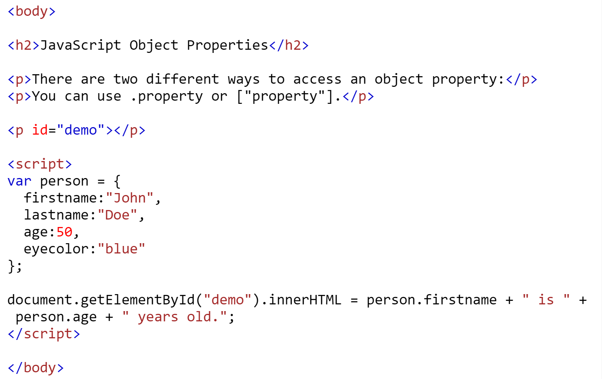
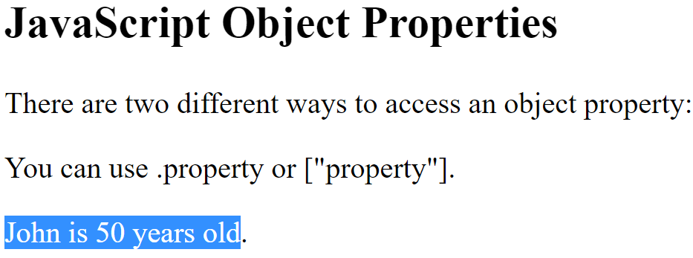
Object Properties
Properties are the values associated with a JavaScript object.
A JavaScript object is a collection of unordered properties.
Properties can usually be changed, added, and deleted.
The example below shows how we can access properties in Javascript Objects.

Slide 21
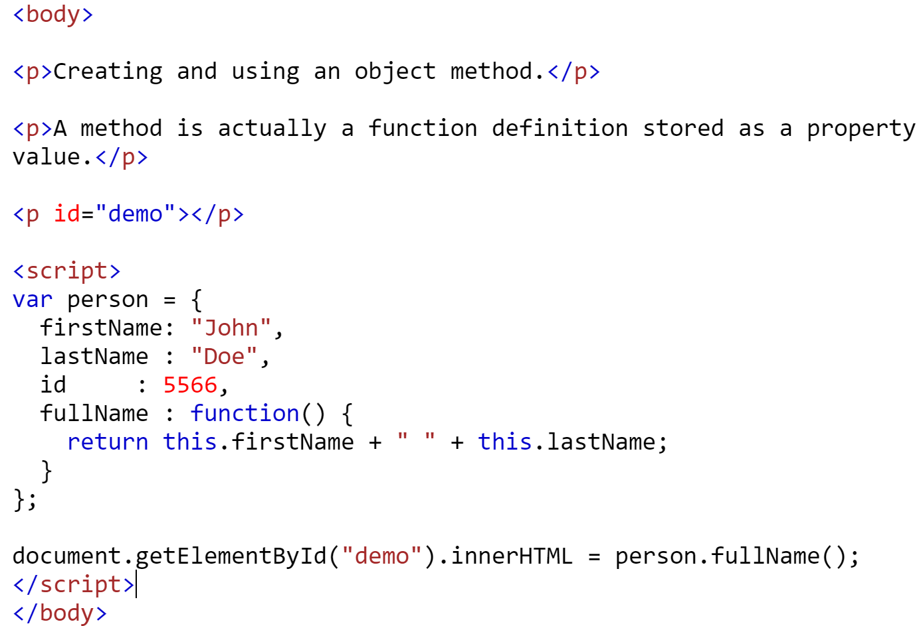
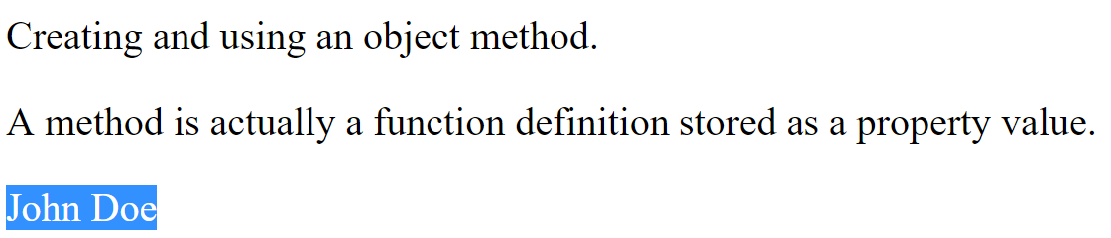
Object Methods
A JavaScript method is a property containing a function definition.
In a function definition, this refers to the "owner" of the function.
In the example below, this is the person object that "owns" the fullName function.
In other words, this.firstName means the firstName property of this object.

Slide 22
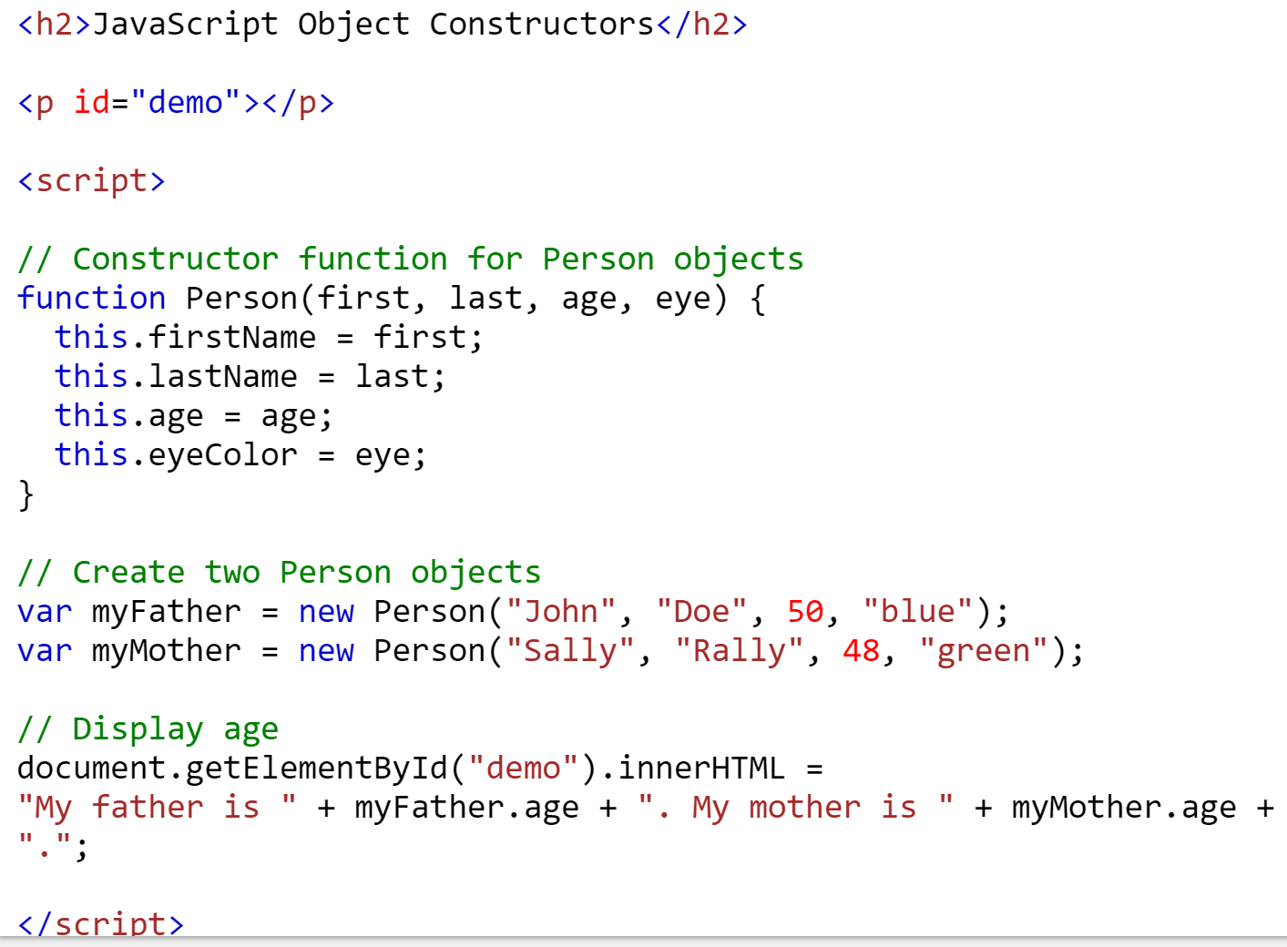
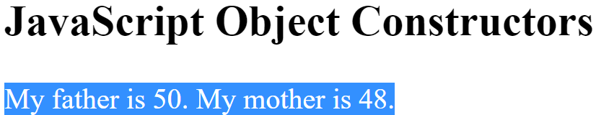
Object Constructors
Sometimes we need a "blueprint" for creating many objects of the same "type".
The way to create an "object type", is to use an object constructor function.
In the example below, function Person() is an object constructor function.
Objects of the same type are created by calling the constructor function with the new keyword:

Slide 23
Arrays
An array is a group of multiple values (called members) that can be assigned to a single variable. It is a way to store a list of items, or values.
The values in an array are said to be indexed, meaning you can refer to them by number according to the order in which they appear in the list. The first member is given the index number 0, the second is 1, and so on.
For example, values in the array foo can be accessed by referencing their index number:
  var foo = [5, "five", "5"];
    alert( foo[0] ); // Alerts "5"
    alert( foo[1] ); // Alerts "five"
    alert( foo[2] ); // Also alerts "5“

Slide 24
Array Methods
Converting Arrays to Strings
  The JavaScript method toString() converts an array to a string of (comma separated) array values.
    var fruits = ["Banana", "Orange", "Apple", "Mango"];
    document.getElementById("demo").innerHTML = fruits.toString();
    Banana,Orange,Apple,Mango
  The join() method also joins all array elements into a string. It behaves just like toString(), but in addition you can specify the separator:
    var fruits = ["Banana", "Orange", "Apple", "Mango"];
    document.getElementById("demo").innerHTML = fruits.join(" * ");
    Banana * Orange * Apple * Mango
Popping and Pushing
  Popping is to remove elements items out of an array, and pushing is to add new elements items into an array.
  The pop() method removes the last element from an array:
    var fruits = ["Banana", "Orange", "Apple", "Mango"];
    var x = fruits.pop();
  The push() method adds a new element to an array (at the end):
    var fruits = ["Banana", "Orange", "Apple", "Mango"];
    var x = fruits.push("Kiwi");

Slide 25
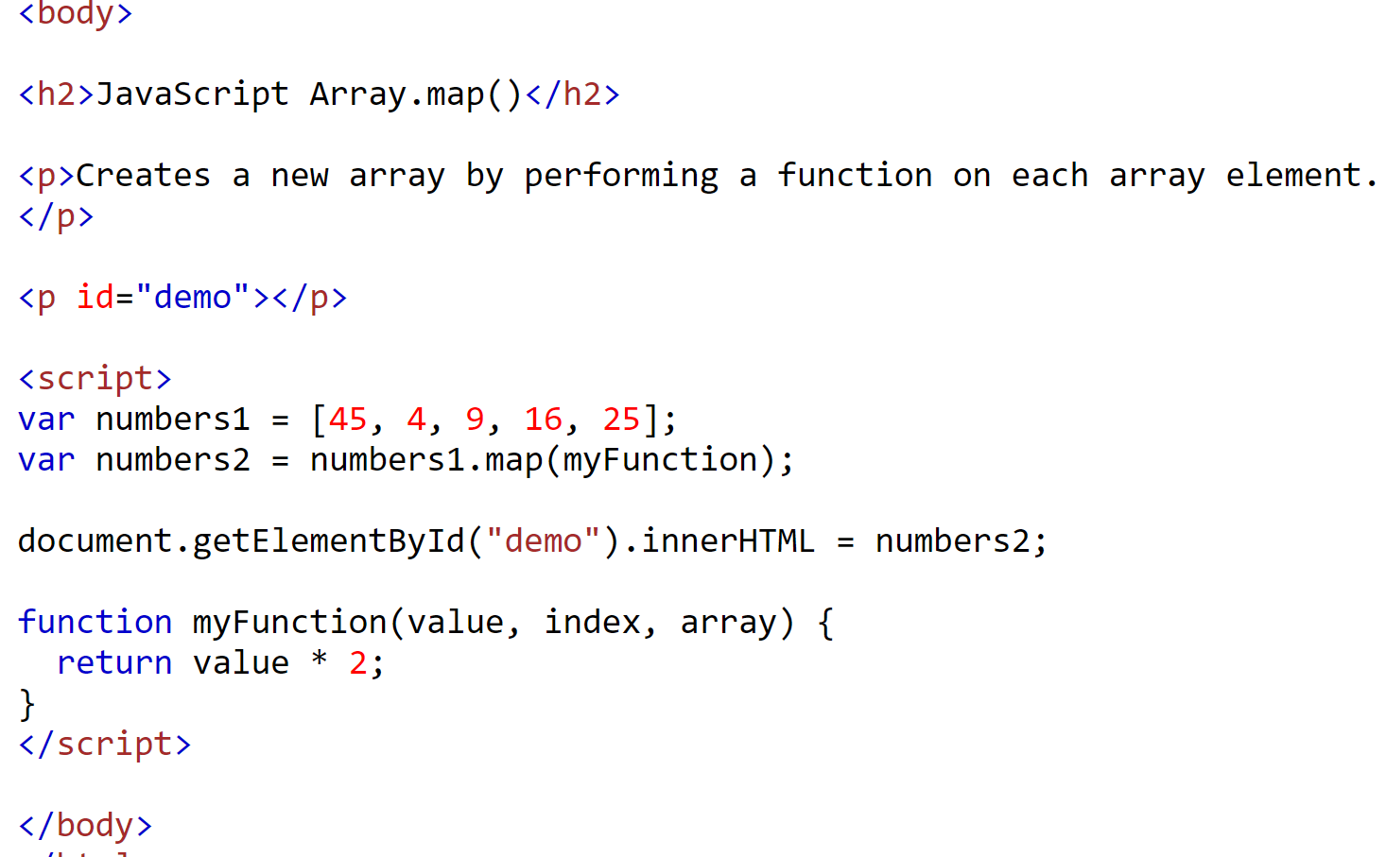

Array Iteration
Array.map()
  The map() method creates a new array by performing a function on each array element.
  The map() method does not change the original array.
  The following example multiplies each array value by 2.

Slide 26
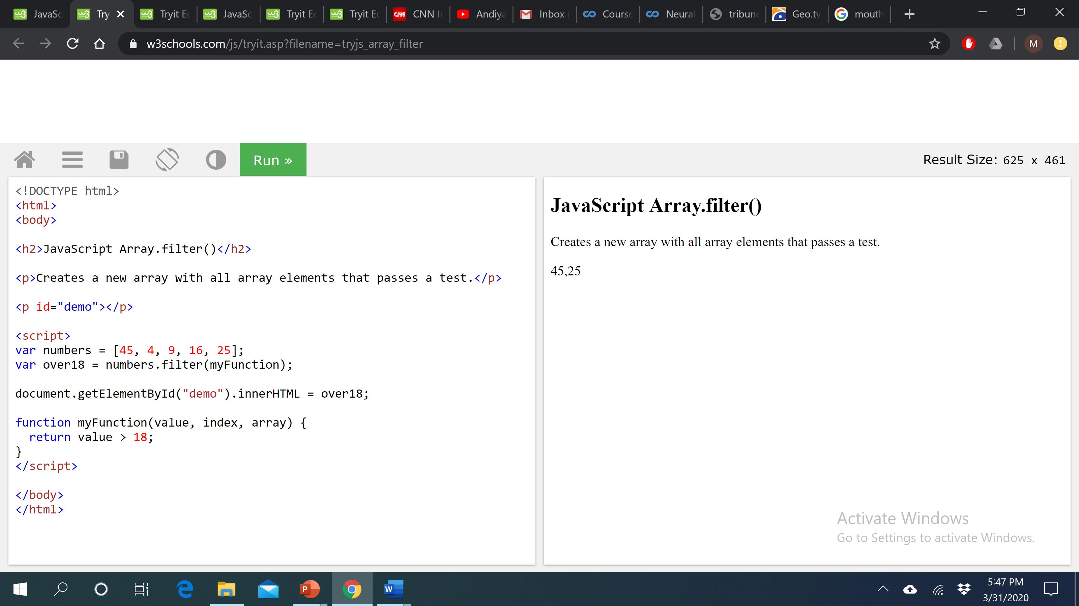
Array Iteration
Array.filter()
  The filter() method creates a new array with array elements that passes a test.
  This example creates a new array from elements with a value larger than 18:

Slide 27
Array Iteration
Visit the following URL to read about below-mentioned Array iteration functions.
  https://www.w3schools.com/js/js_array_iteration.asp
  Array.reduce()
  Array.reduceRight()
  Array.every()
  Array.some()
  Array.indexOf()
  Array.lastIndexOf()
  Array.find()
  Array.findIndex()

Slide 28
Comparison Operators
When we compare two values, JavaScript evaluates the statement and gives us back a Boolean value depending on whether the statement is true or false.
  == Is equal to
  != Is not equal to
  === Is identical to (equal to and of the same data type)
  !== Is not identical to
  > Is greater than
  >= Is greater than or equal to
  < Is less than
  <= Is less than or equal to
  alert( 5 == “5” ); // This will alert "true"
  alert( 5 != 6 ); // This will alert "true"
  alert( 5 < 1 ); // This will alert "false"

Slide 29
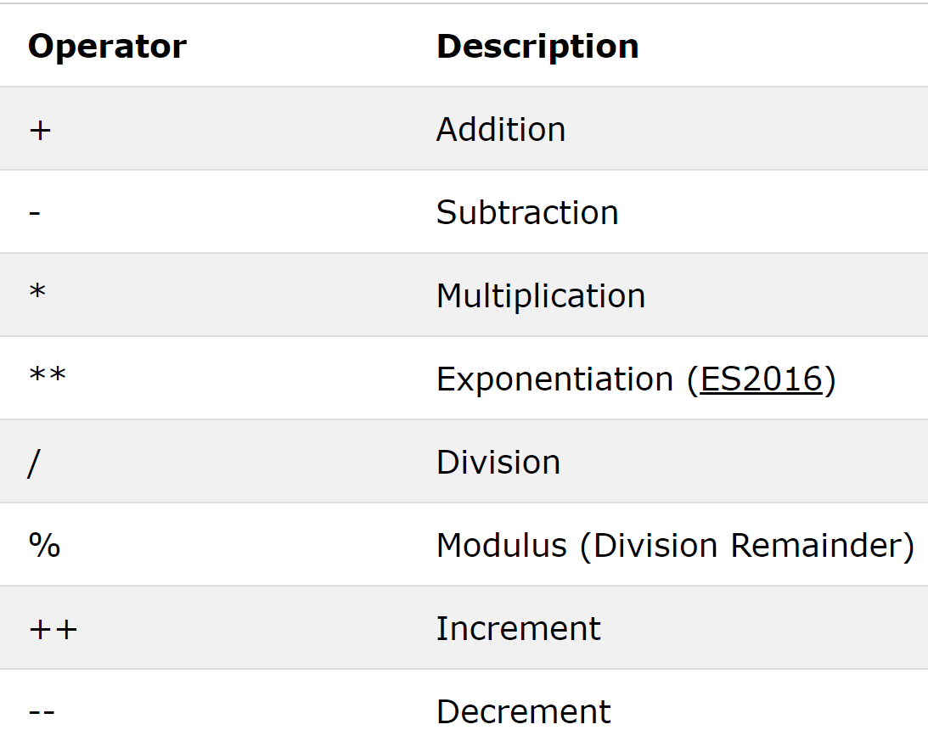
Arithmetic Operators
Arithmetic operators are used to perform arithmetic on numbers.

Slide 30
Summary of Today’s Lecture
JavaScript Introduction
Variable Declaration
Data Types
Comparison Operators
Arithmetic Operators

Slide 31
Resources
Chapter 19 and Chapter 20 from Learning Web Design- A Beginner’s Guide to HTML, CSS, Javascript and Web Graphics By Jennifer Niederst Robbins (4th Edition)
https://www.w3schools.com/js/
https://www.tutorialrepublic.com/javascript-tutorial/

